Slide 1

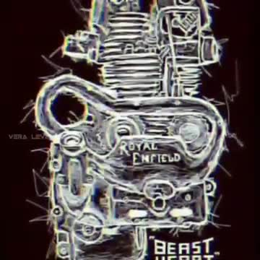

Slide 2
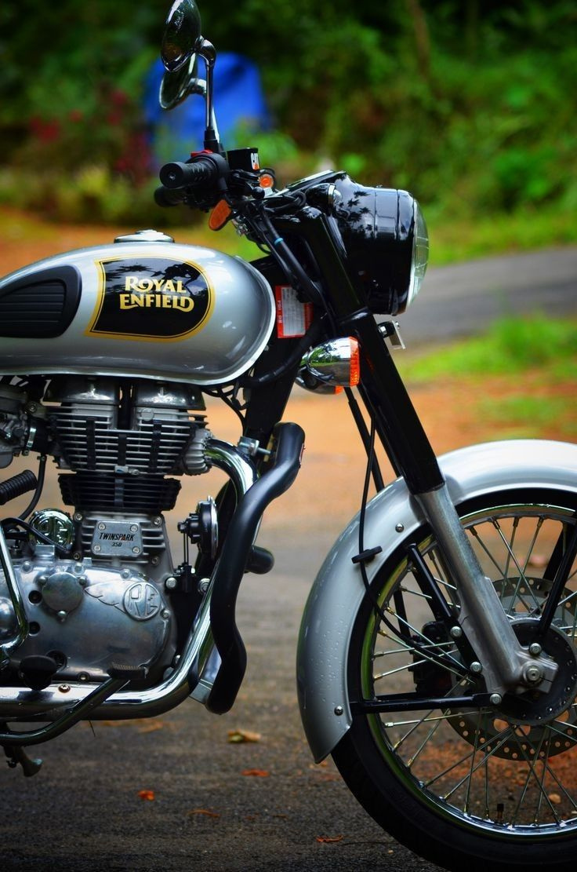

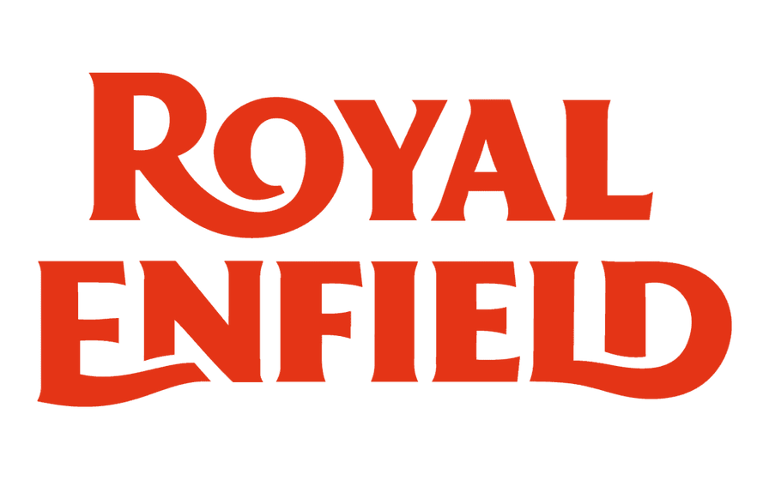
MADE LIKE A GUN
BRAND MANAGEMENT
SUBMITTED TO: DR. SANKET VATAWALA
PRESENTED BY: GROUP 4

Slide 3
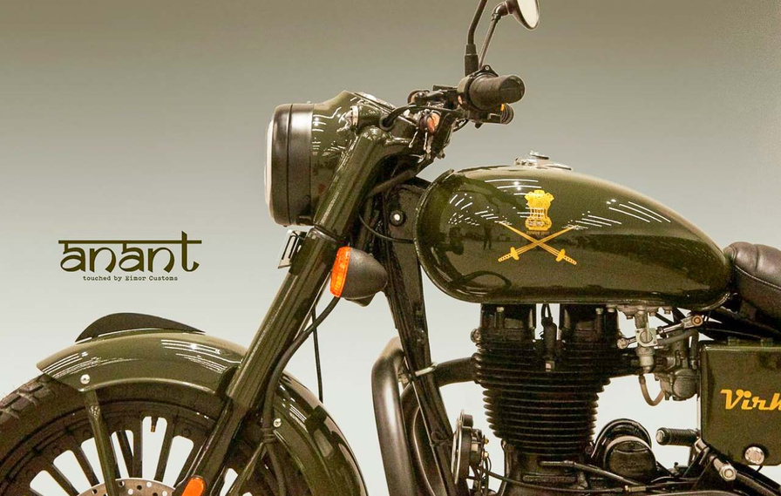

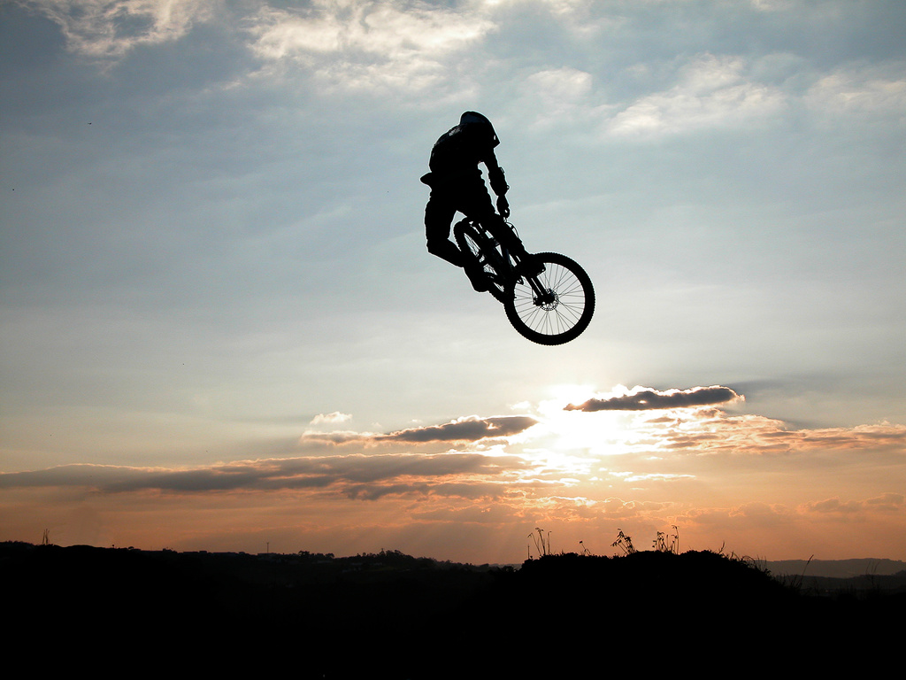
05
VISION
To inspire motorcycling adventures and create timeless experiences, blending heritage with modern innovation while fostering a global community of passionate riders
MISSION
To design and build simple, accessible, and evocative motorcycles that celebrate the joy of riding.
To uphold the legacy of craftsmanship and engineering excellence while evolving with modern advancements.
To promote a strong riding culture and brotherhood through global communities, events, and experiences.
To ensure sustainability and durability in products, supporting long-term reliability and environmental responsibility.

Slide 4
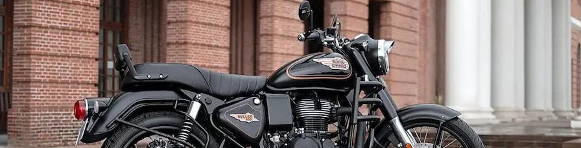
02
Royal Enfield, founded in 1901 in the UK, is the world’s oldest motorcycle brand in continuous production. Initially a British brand, it became an Indian icon after 1971 and is now owned by Eicher Motors. Known for its classic design, thumping exhaust, and rugged appeal, it has evolved into a global lifestyle brand representing freedom, adventure, and heritage.
ROYAL ENFIELD: MORE THAN JUST A MOTORCYCLE
WHY ROYAL ENFIELD?
120+ Years of Legacy – Established in 1901, the oldest continuously running motorcycle brand.
Revival to Market Leader – From near bankruptcy in the 90s to dominating the mid-size segment.
Cultural Icon – More than a bike; it’s a lifestyle and a thriving community.
Beyond Motorcycles – Expanding into apparel, accessories, and riding experiences.
Future-Ready – Investing in EVs, global expansion, and digital innovation.

Slide 5
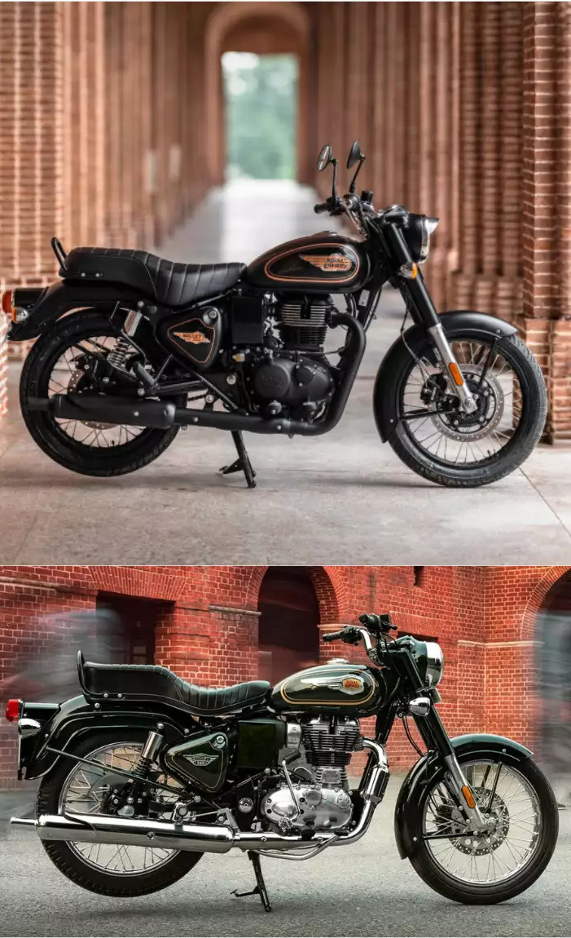
HISTORY OF ROYAL ENFIELD
03
THE LEGACY, CHALLENGES & REVIVAL OF ROYAL ENFIELD
1901-1954: THE BIRTH OF AN ICON
1955-1994: EXPANSION INTO INDIA & OWNERSHIP SHIFT
Founded in Redditch, UK (1901) – One of the world’s oldest motorcycle brands.
Launched the first Royal Enfield motorcycle with a single-cylinder engine.
Introduced the legendary slogan "Made Like a Gun", symbolizing durability and strength.
1955: Partnered with Madras Motors, started manufacturing in India.
1965-1980s: Bullet 350 became the Indian Army’s motorcycle of choice.
1971: UK operations shut down, Royal Enfield became fully Indian.
1994: Acquired by Eicher Motors, marking the beginning of a transformation phase.
📍 LATE 1990S - EARLY 2000S: STRUGGLES & CHALLENGES
📍 2000S-PRESENT: THE GREAT REVIVAL & GLOBAL SUCCESS
Challenges (1990s-2000s) | Revival Strategies (2000s-Present)
Declining Sales | Revamped marketing & brand identity
Outdated Models | Launched Classic 350, Himalayan, 650 Twins
Competition from Honda, Bajaj, Yamaha | Repositioned as a premium, lifestyle brand
Limited Global Reach | Expanded into 60+ countries

Slide 6
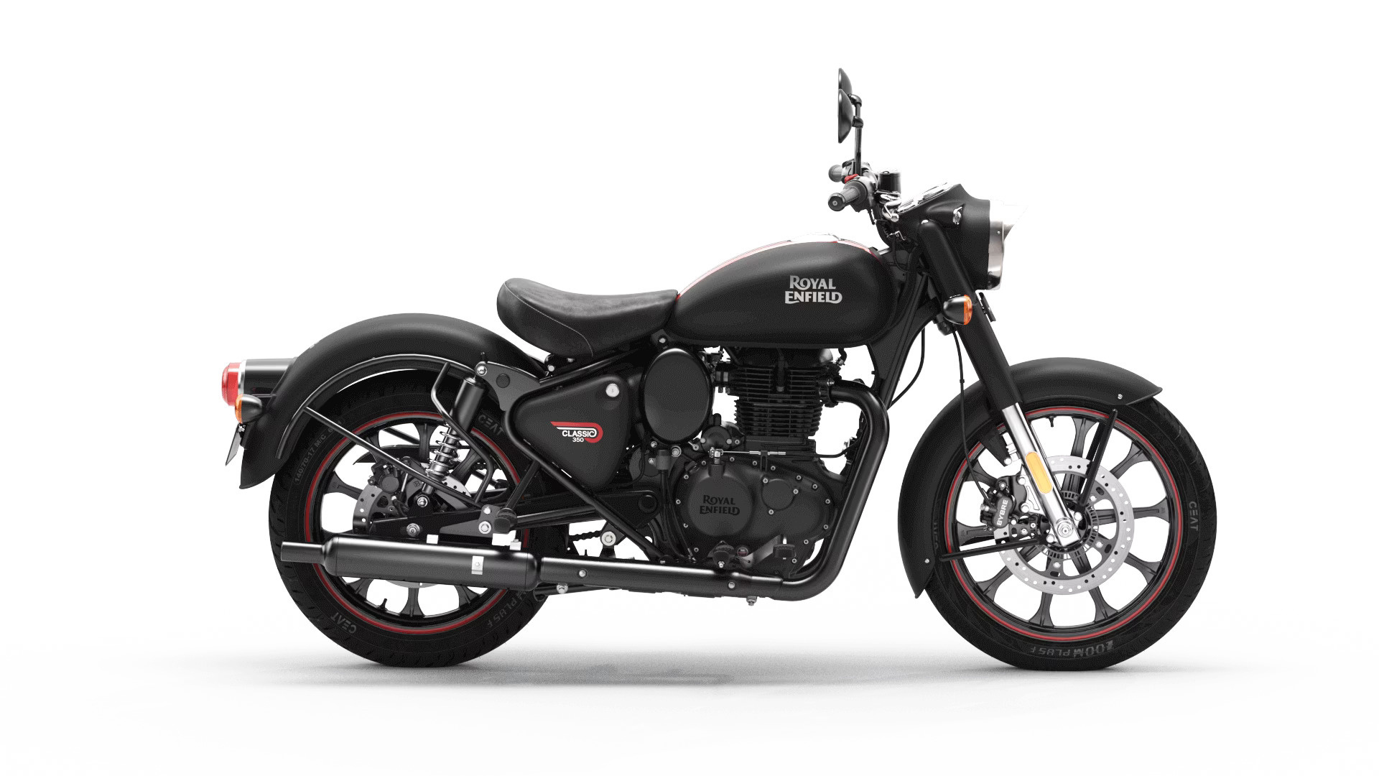

ROYAL ENFIELD’S BRAND IDENTITY
04
Brand Name: Royal Enfield
Symbolises heritage, prestige, and rugged reliability.
Rooted in British origin and Indian legacy, appealing to adventure and classic motorcycle enthusiasts.
Logo & Evolution - Vintage crest-style logo with bold typography, emphasizing tradition, power, and durability.
Tagline
“Made Like a Gun” – Represents strength, durability, and robust engineering.
Jingle & Brand Sound
No fixed jingle, but heroic, empowering music in ads reflects freedom & adventure, while the distinct thumping exhaust sound remains a key brand identifier.
Design Language & Styling
Retro-inspired styling – Classic round headlamps, metal body, and chrome finishes, blending heritage with modern performance.
Merchandise & accessories
Riding gear, helmets, jackets, toolkits etc.
Online Presence & Digital Engagement
Website: www.royalenfield.com – Offers bike customization (Make It Yours - MIY), product browsing, and brand storytelling.
Social Media: Strong presence on Instagram, YouTube, Facebook, and X, leveraging user-generated content, brand campaigns, and product launches.

Slide 7
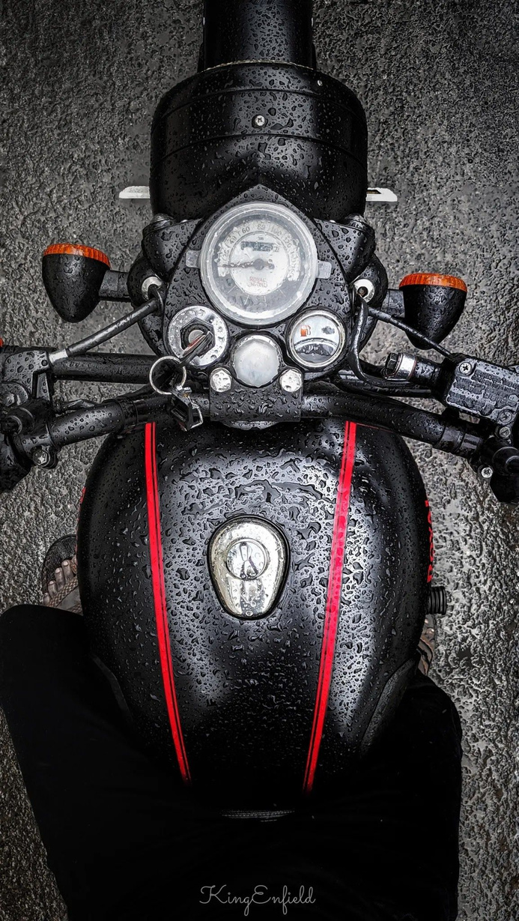
4 P’S OF ROYAL ENFIELD’S
05
PRODUCT:
CLASSIC & CUSTOMIZABLE OFFERINGS
PRICE:
MID-PREMIUM POSITIONING
Motorcycles: Retro-styled yet modern – Classic 350, Meteor 350, Himalayan, Super Meteor 650, Interceptor 650.
Customization (MIY Program): Personalize paint, accessories, seats, and mirrors.
Beyond Bikes: Riding gear, apparel, luggage, and motorcycle accessories.
Differentiator: Unique Ownership Experience.
Affordable Premium: Positioned between Honda/Yamaha (mass-market) and Harley-Davidson/Triumph (premium).
Price Range: ₹1.9L - ₹4L+ ($2,300 - $5,000 USD).
Customisation-Pricing: MIY allows variable pricing based on modifications.
Differentiator: Premium feel at a mid-segment price.
PLACE:
EXPANDING GLOBAL REACH
PROMOTION:
EXPERIENTIAL & DIGITAL MARKETING
2,000+ dealerships across India for strong market penetration.
Flagship Stores
Growing internationally – Southeast Asia, Latin America, North America, and Europe.
Online-to-Offline (O2O) Model – Digital bookings, test rides, and purchases.
Differentiator: Seamless digital + offline buying experience.
Experiential Branding: Events like Rider Mania & Himalayan Odyssey to build community, Royal Enfield Riders clubs, Motoverse Festival
Social Media Dominance: 5M+ Instagram, 3M+ YouTube subscribers.
Influencer & Celebrity Collaborations: Bollywood actors, travel bloggers, and riders.
Differentiator: Brand marketing focuses on experience, not just products.

Slide 8
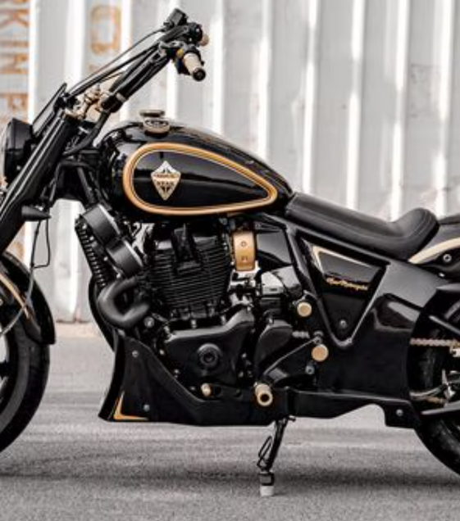
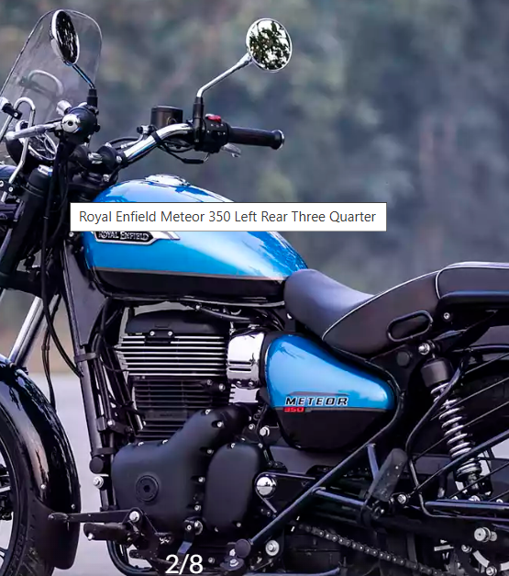
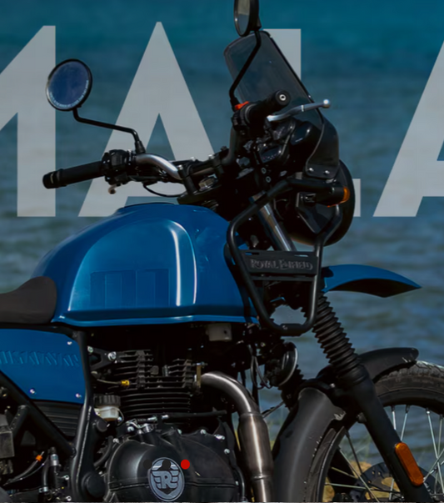
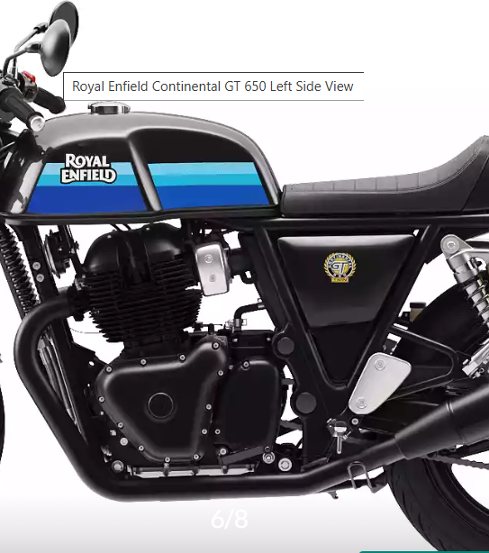
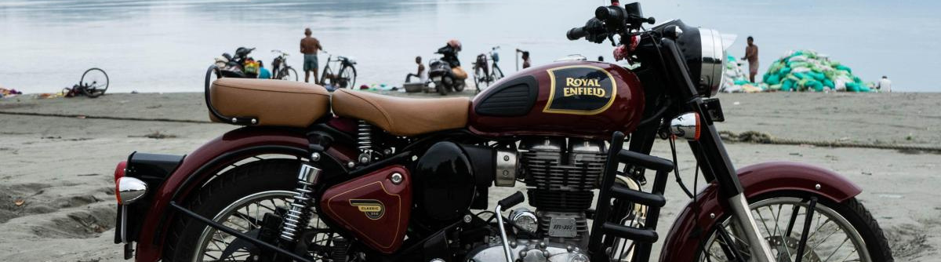
11
PORTFOLIO

Slide 9
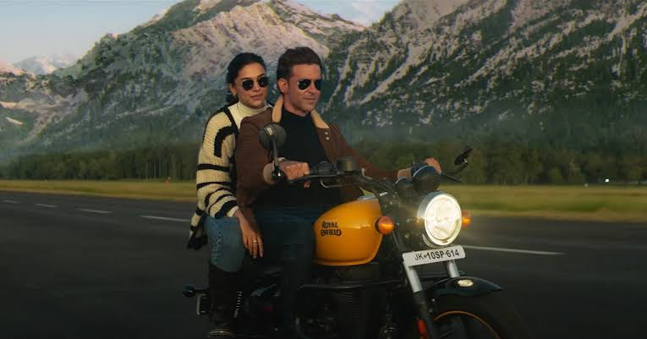
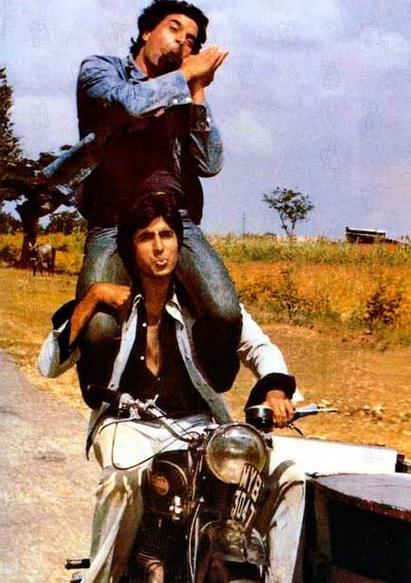
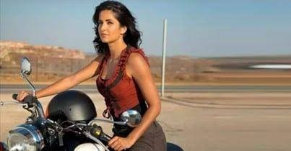
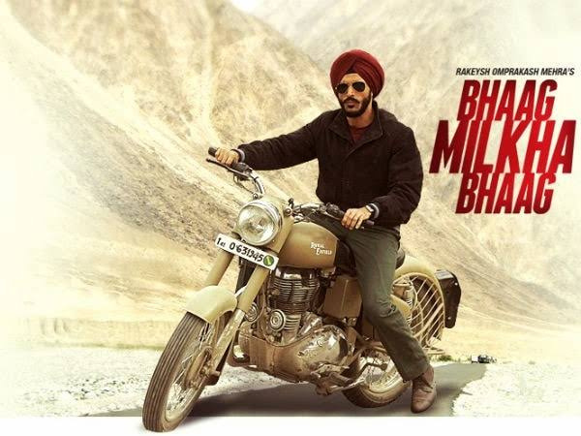
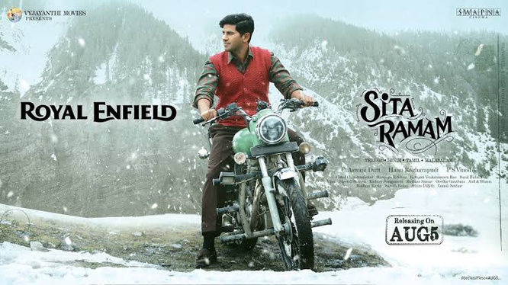
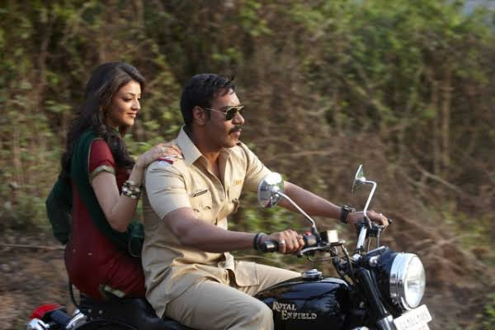
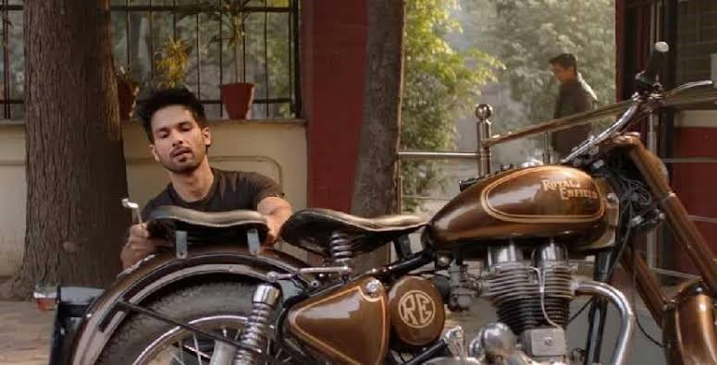
08
KEEP FORWARD,
DON'T BE AFRAID TO FAIL
@REALLYGREATSITE

Slide 10
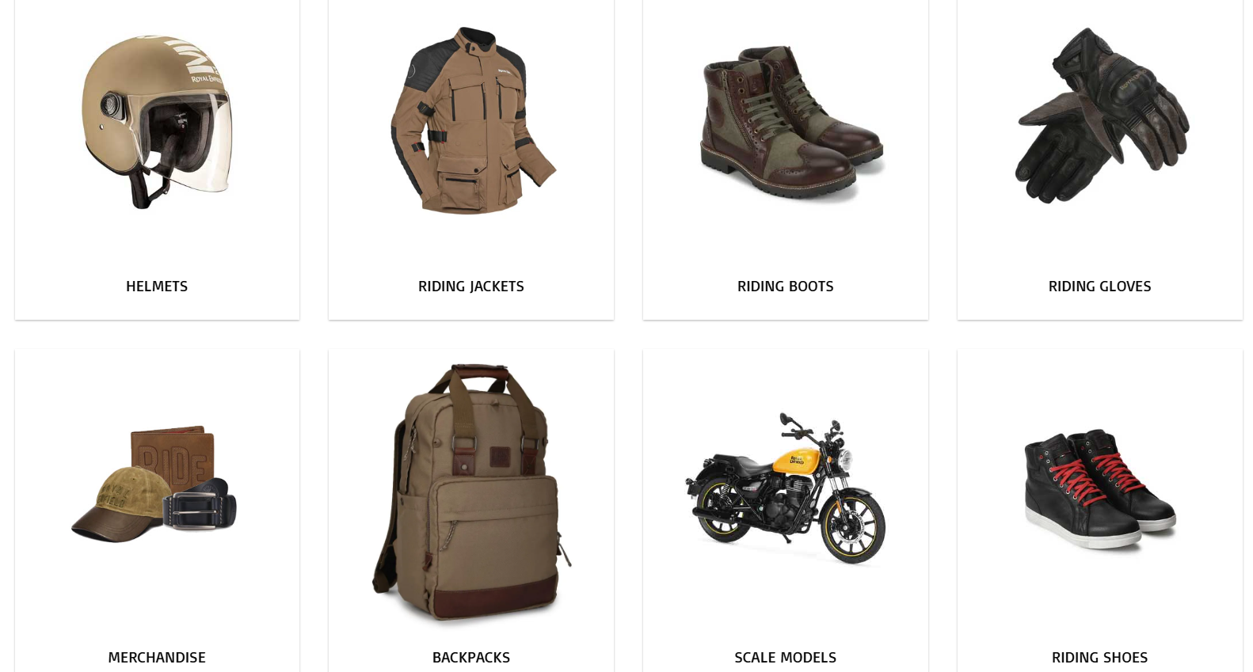
09
BEST CREW

Slide 11
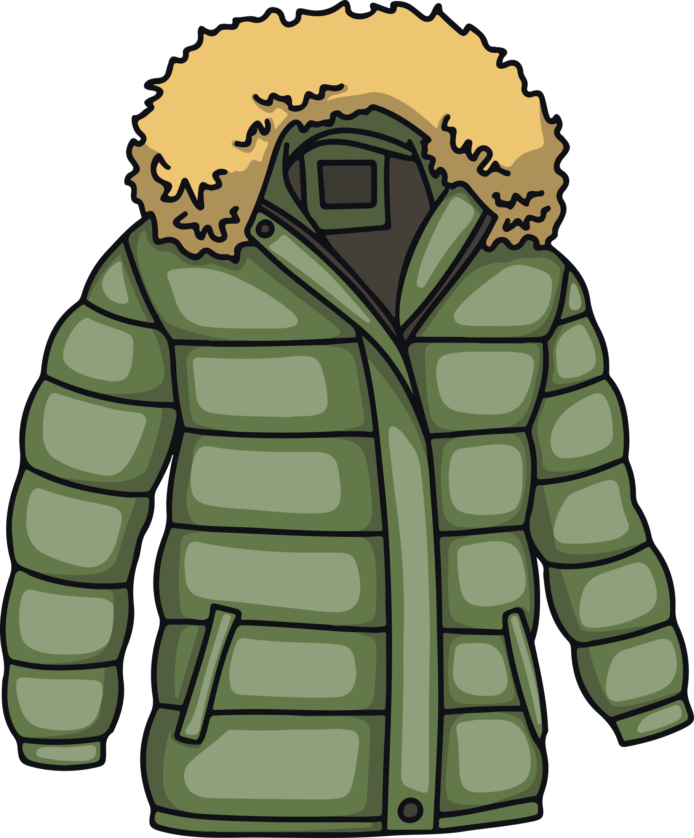


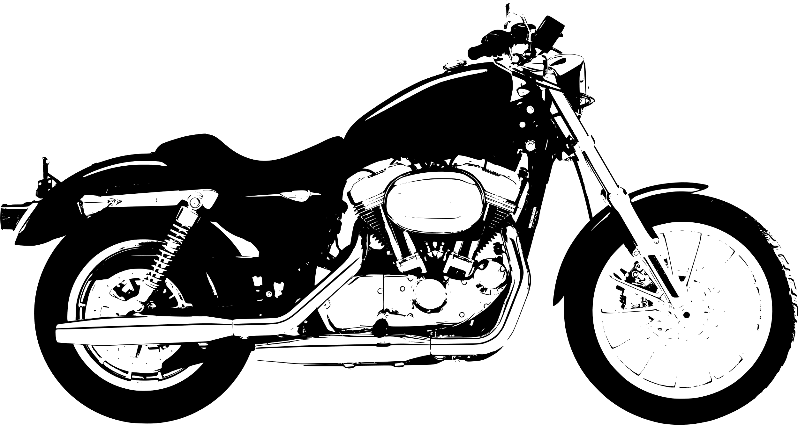


SUN PLANET FRAMEWORK
09

Slide 12
6 M model
03
1. Market (Target Audience)
Young Enthusiasts & Adventure Riders – Looking for a rugged, stylish ride.
Classic Bike Lovers – Nostalgic for vintage motorcycles and the "Dug-Dug" sound.
Long-Distance Tourers – Riders who need durability for long journeys.
Customization Enthusiasts – Bikers who love modifying and personalizing their bikes.
2. Mission (Marketing Objectives)
Strengthen brand heritage & legacy appeal.
Expand the touring & adventure market segment.
Promote modern tech integration while preserving the classic essence.
Boost community engagement and loyalty programs.
3. Message (Brand Communication)
"Built Like a Gun, Goes Like a Bullet" – Reinforces power, durability, and legacy.
Emphasize freedom, adventure, and brotherhood in campaigns.
Highlight key USPs: retro design, iconic sound, and customization options.
4. Media (Channels & Platforms)
Digital: Social media (YouTube, Instagram), influencer collaborations, website content.
Traditional: TV commercials, print ads in biking & adventure magazines.
Events & Sponsorships: Rider meetups, biking expeditions, motorsport sponsorships.
Retail & On-Ground: Branded stores, dealership experiences, test rides.
5. Money (Budget & Allocation)
6. Measurement (Performance Metrics)
Sales Growth – New bike sales, repeat purchases.
Brand Engagement – Social media followers, content engagement, user-generated content.
Community Participation – Event attendance, RE riding club memberships.
Market Share – Growth in the cruiser & adventure bike segments.

Slide 13
QUESTIONNAIRES

Slide 14
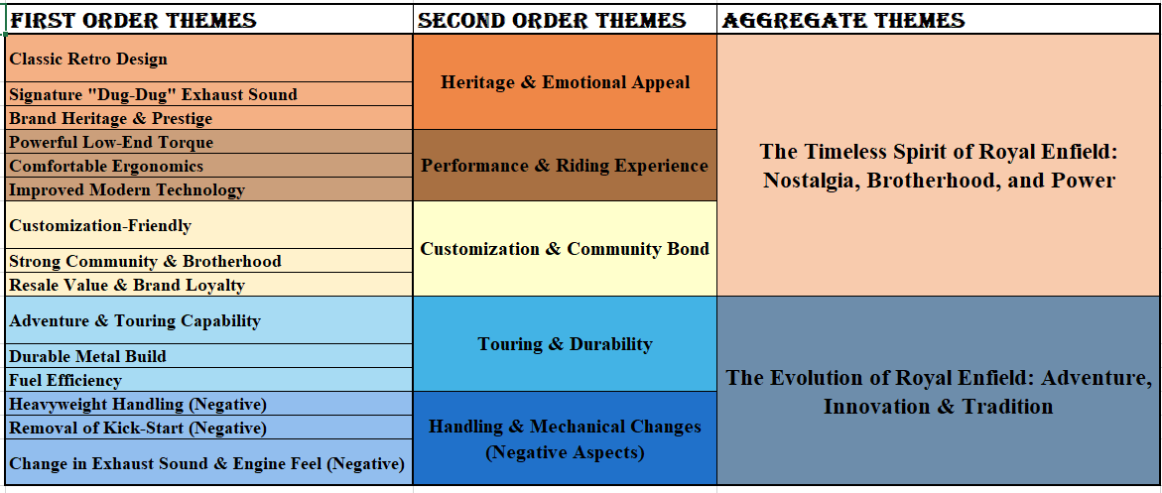
RESULTS

Slide 15
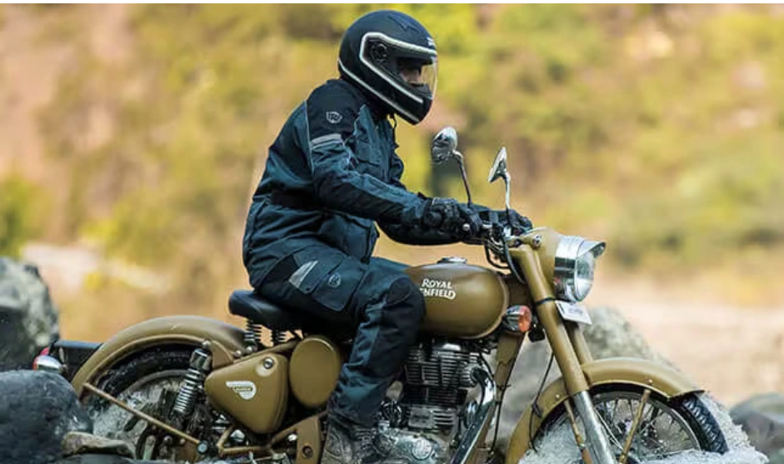
SURVEY FINDINGS ACROSS ALL 4 QUESTIONNAIRES
03
The Timeless Spirit of Royal Enfield
Heritage & Nostalgia – Classic design, dug-dug sound, and brand legacy.
Performance & Comfort – Powerful torque, smooth ride, and modern upgrades.
Community & Customization – Strong brotherhood and personalization appeal.
The Evolution of Royal Enfield
Touring & Durability – Built for long rides with a rugged, reliable frame.
Modern Enhancements – Fuel efficiency, refined engine, and updated tech.
Minor Concerns – Removal of kick-start, exhaust sound changes.
Customer Sentiment
New Buyers: 17% might consider other cruisers.
Existing Owners: Only 3% would switch if another brand matched RE’s legacy.
Loyal Customers: Brand feels like family; nostalgia outweighs minor changes.
The iconic exhaust note still ignites passion across generations.

Slide 16

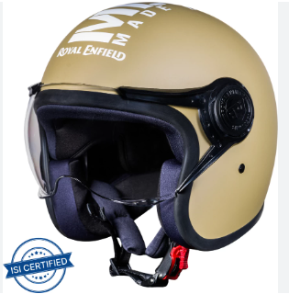
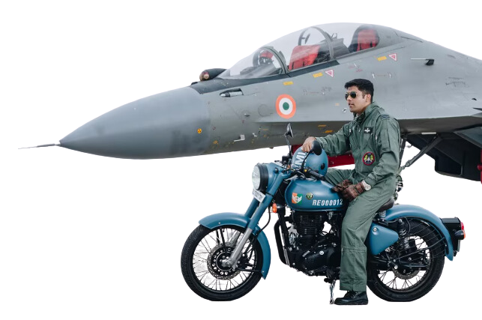
BRAND ASSET VALUATOR
13
DIFFERENTIATION
RELEVANCE
ESTEEM
KNOWLEDGE
SHOP NOW

Slide 17


BRAND RESONANCE PYRAMID
Feel like part of a global community through Riders’ clubs
HOW DEEPLY CONNECTED ARE YOU WITH ME?
Brand Resonance
Trusted brand known for heritage and classic appeal.
Owners describe riding an RE as “nostalgic, powerful, and liberating
WHAT DO I THINK & FEEL ABOUT YOU?
Judgment & Feelings
Built for long journeys & rugged terrain.
Associated with freedom, adventure
Performance & Imagery
WHAT ARE YOU?
Easy recall: iconic design (Classic 350, bullet), dug dug sound
Salience
WHO ARE YOU?

Slide 18
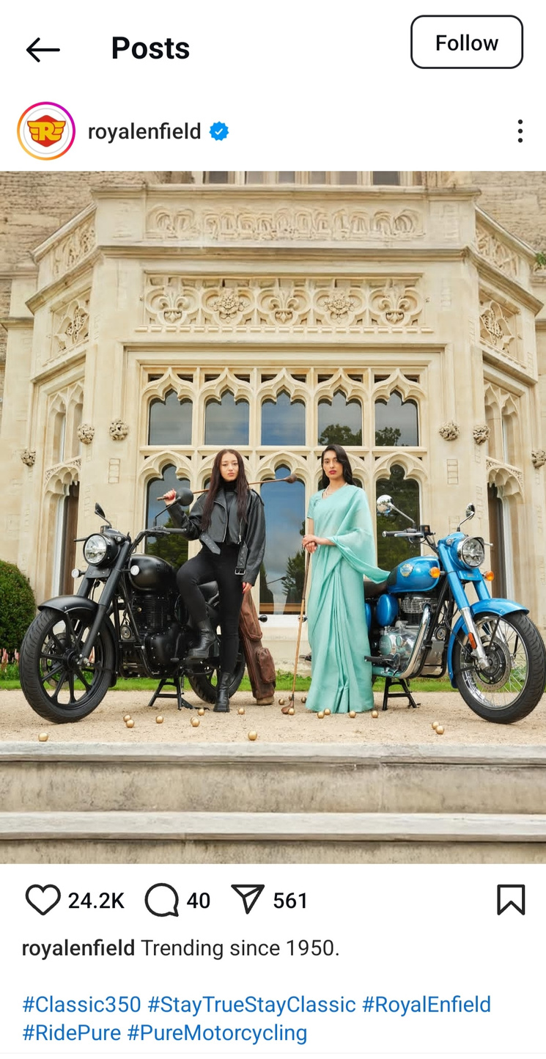
5C FRAMEWORK
1. Conversation Channel
Social Media: Instagram, Facebook, YouTube (user-generated content).
Events & Rides: Rider Mania, Himalayan Odyssey.
Rider Clubs: Local & global communities.
2. Conversation Source
Brand Content: Royal Enfield stories, historical legacy.
Influencers & Celebrities: Bollywood actors, moto vloggers.
Customer Testimonials: Positive riding experiences & nostalgia.
3. Content Themes
Adventure & Freedom: Long rides, road trips, travel experiences.
Customization: Make It Yours (MIY) program for personalizing bikes.
Heritage & Storytelling: Brand history, legacy of the Bullet.
4. Channel-Specific Content
Instagram: Visual storytelling (adventure shots, bike modifications).
YouTube: Rider documentaries, bike reviews, road trip vlogs.
5. Context
Positioned as a lifestyle brand, not just a motorcycle company.
Appeals to rebellion, nostalgia, and adventure seekers.

Slide 19
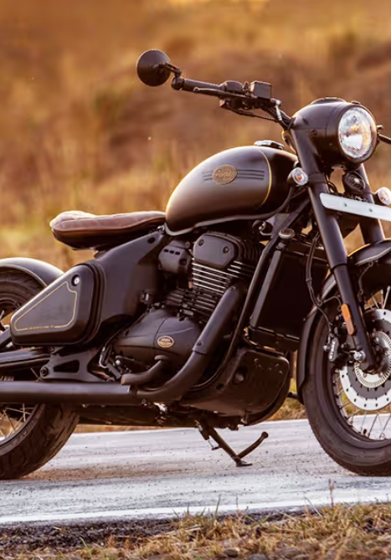

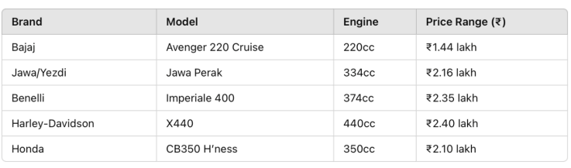
14
COMPETITOR’S BIKES

Slide 20
RECOMMENDATIONS
Innovation & Sustainability:
Develop electric models while retaining the classic feel.
Focus on lightweight & fuel-efficient models for city riders.
New Market Expansion:
Increase presence in Asia & Africa as it’s ideal for mid premium segment.
Offer affordable financing options.
Digital & Influencer Marketing:
More personalized digital campaigns: customized bike content, owner endorsement.
Collaborations with travel & moto influencers to gauge young audience.

Slide 21
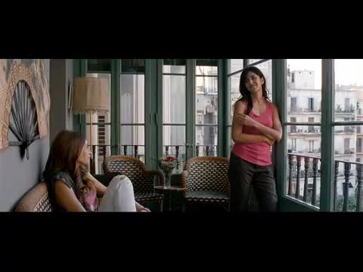
12
THANK
YOU
SEE MORE

